Slide 1
Architecture design and Code analysis for YouTube channel

Slide 2
agenda
Architecture Design
Visual Analysis
Area of improvement

Slide 3

Architecture Design

Slide 4
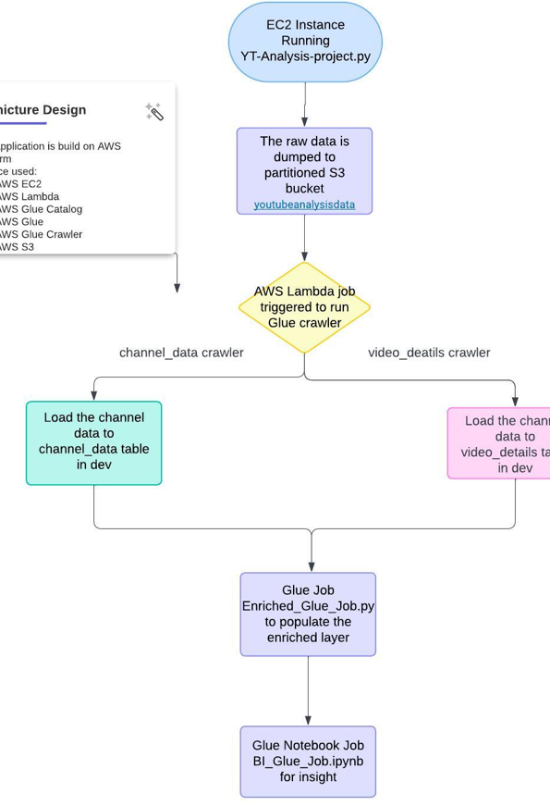
Architecture Diagram

Slide 5

Visual analysis

Slide 6
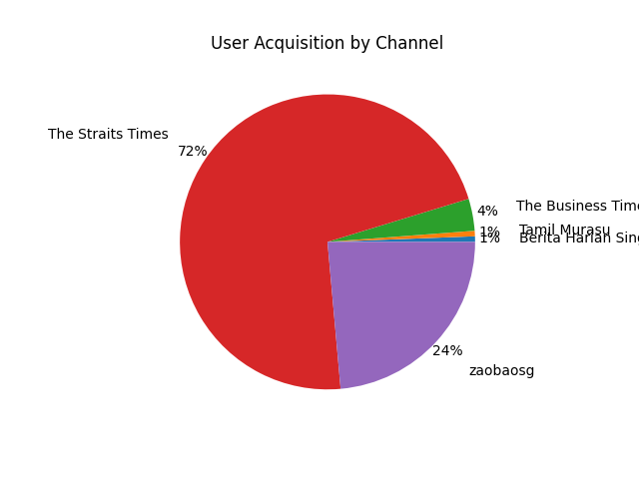
User acquisition by channel

Slide 7
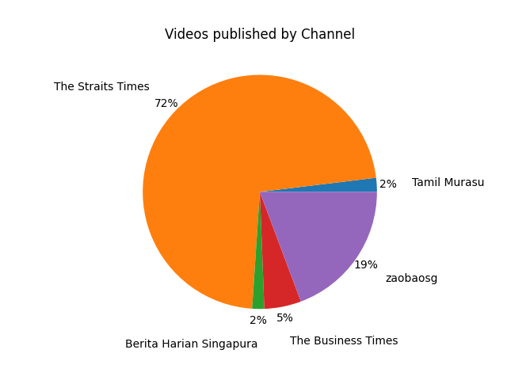
Video published by channel

Slide 8
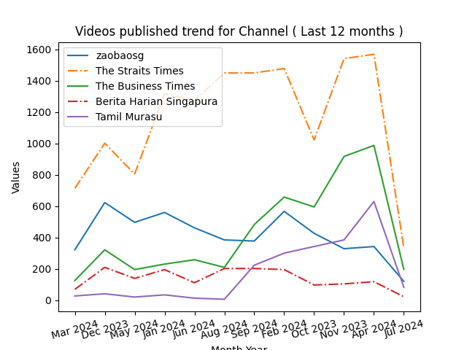
Videos trend by channel

Slide 9
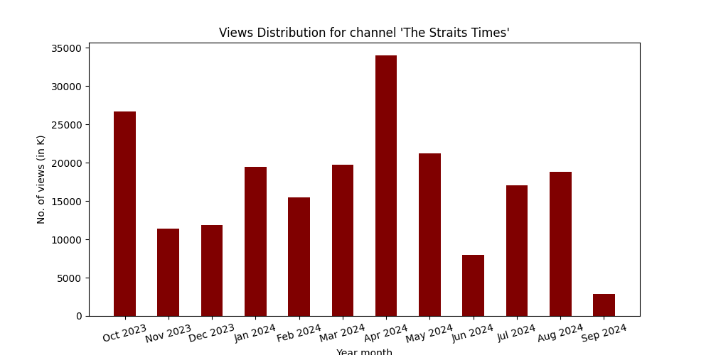
Video published by channel per month

Slide 10
Area of improvements
The whole process can be automated by using AWS Step function or Airflow.
The data can be moved to AWS redshift for taking the database like features.

Slide 11

Important link
Github code link https://github.com/sumanh458/AWS/tree/main

Slide 12
Thank you
Suman Haldar
+91 7008370068
sumanh458@gmail.com
Linkedin Profile: https://www.linkedin.com/in/suman-haldar-55986674/

